Slide 1
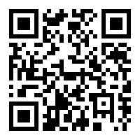

What Is Mobile Health?
Alex Mariakakis
University of Toronto
Department of Computer Science
http://bit.ly/mariakakis-mhealth-intro

Slide 2
Definitions of mHealth
“The use of mobile and wireless devices to improve health outcomes, health care services, and health research” – National Institutes of Health
“Medical and public health practice supported by mobile devices” – World Health Organization
“The monitoring and sharing of health information via mobile technology” – Business Insider

Slide 3
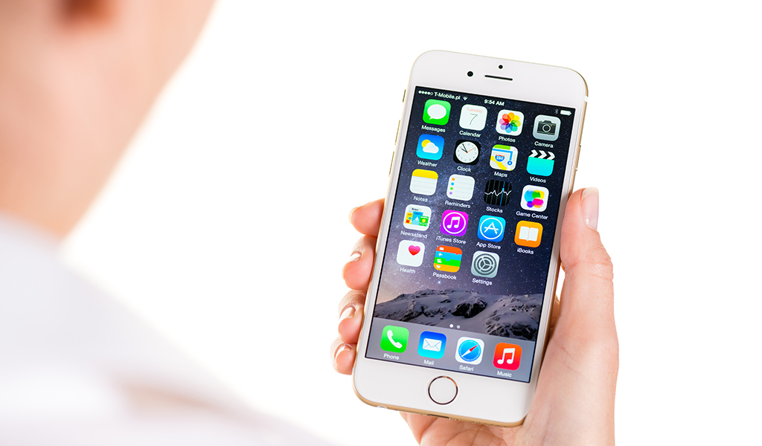
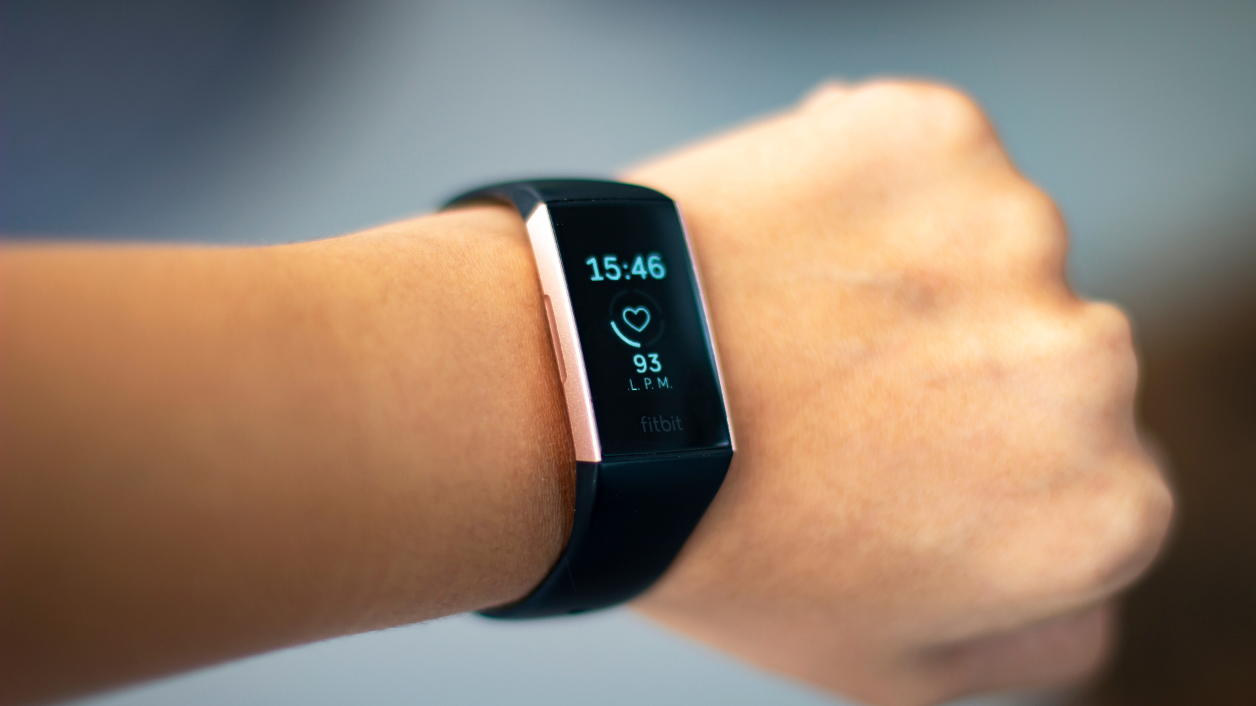
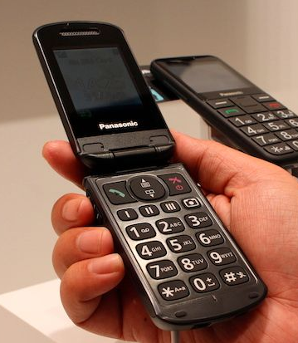
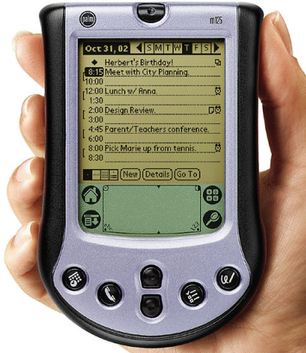
“Traditional” Mobile Devices
Smartphones
Smartwatches & Fitness Trackers
Mobile / “Feature” Phones
Palm Pilots / PDAs

Slide 4
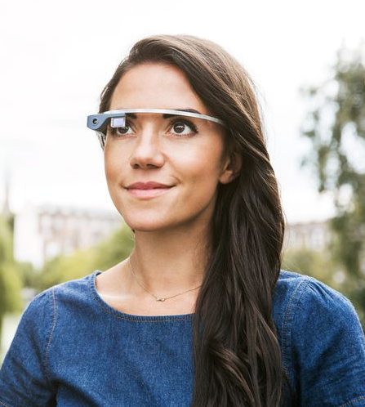
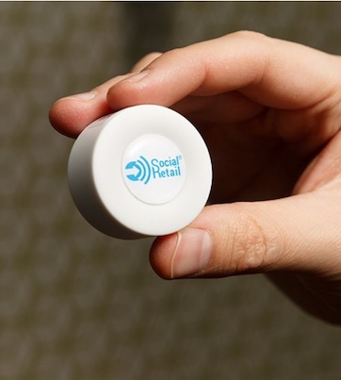
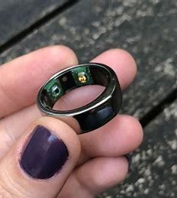
“Cutting Edge” Mobile Devices
Smart Glasses
Bluetooth Beacon
Smart Rings

Slide 5
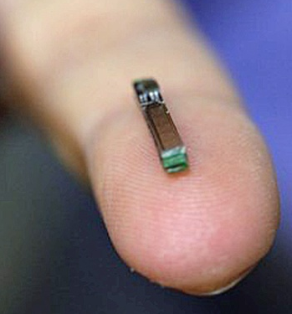
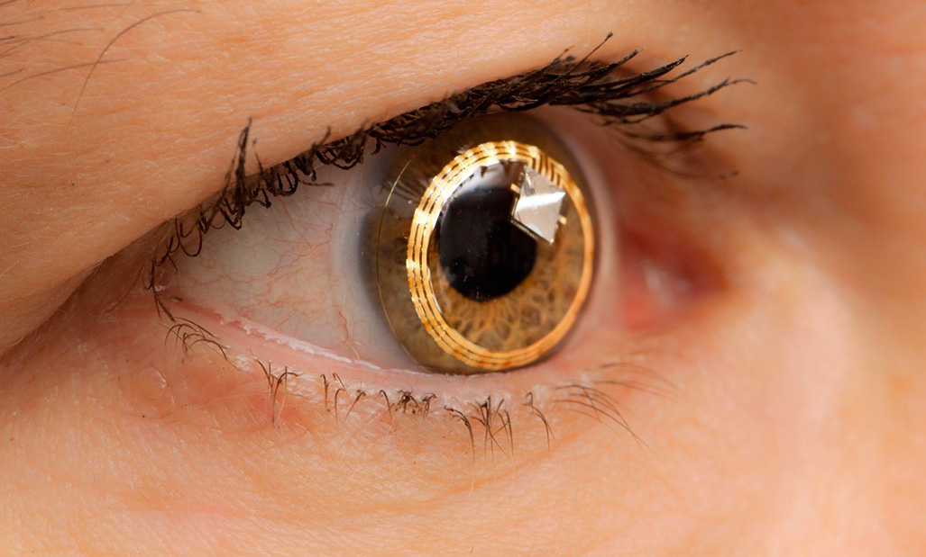
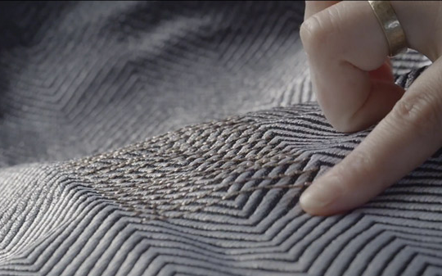
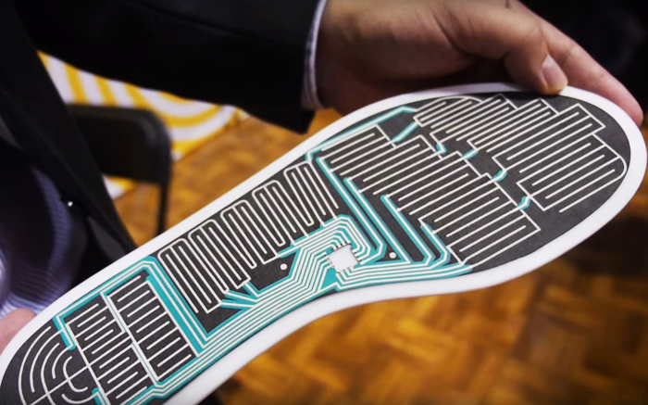
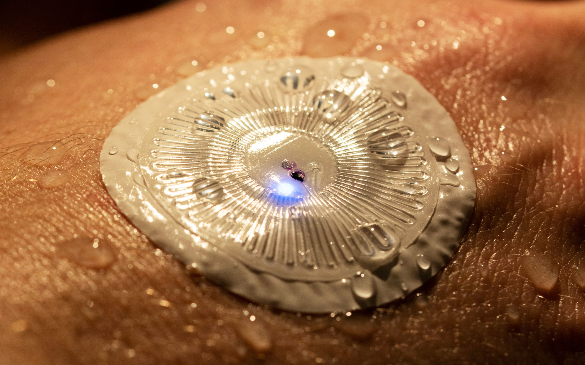
“Emerging” Mobile Devices
Implantables
Smart Contact Lenses
Smart Fabrics
Smart Shoes
Skin Sensors

Slide 6
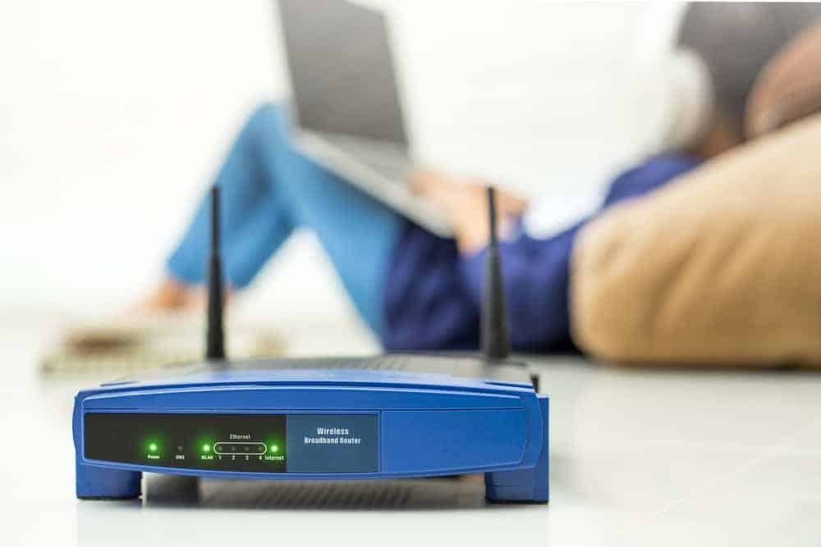
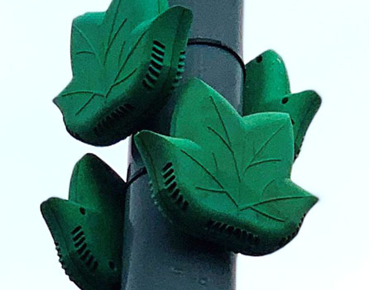
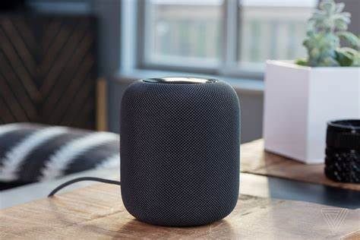
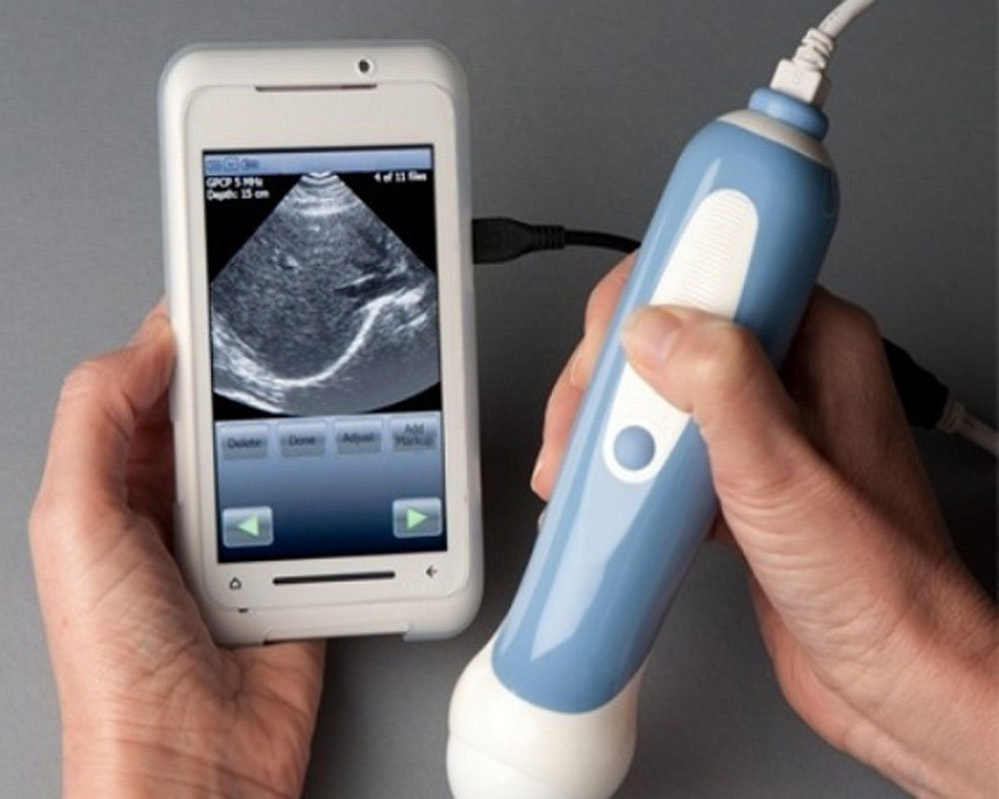
Other Ubiquitous Technologies for Health
Desktops and laptops
Mobile phone attachments
Wireless sensing
Smart speakers
Environment sensors

Slide 7
Advantages of Mobile Devices
Smartphone penetration is high
67% of the global population has a mobile phone; 48% has a smartphone (BankMyCell ‘21)
In sub-Saharan Africa, 86% of people will have a SIM connection, and 65% of them will come from a smartphone (GSMA ’20)
Consistently high across genders, ethnicities, socio-economic status
Potentially quicker path to major impact
Note: This data does not mean we can assume that everyone has a mobile phone

Slide 8
Advantages of Mobile Devices
Mobile devices are often nearby
People keep their smartphone is within arm’s reach 50% of the time and in the same room 90% of the time (Dey et al. ‘11)
People wear their smartwatches for ~9 hours per day (Jeong et al. ‘17)
More opportunities for sensing, interaction, and intervention

Slide 9
Advantages of Mobile Devices
Mobile devices are familiar interfaces
Many people are willing to keep their phone in working condition
Many people are willing to upgrade their phone on a semi-regular basis, leading to better hardware over time
Can leverage common interaction patterns and familiar interfaces to make usable apps

Slide 10
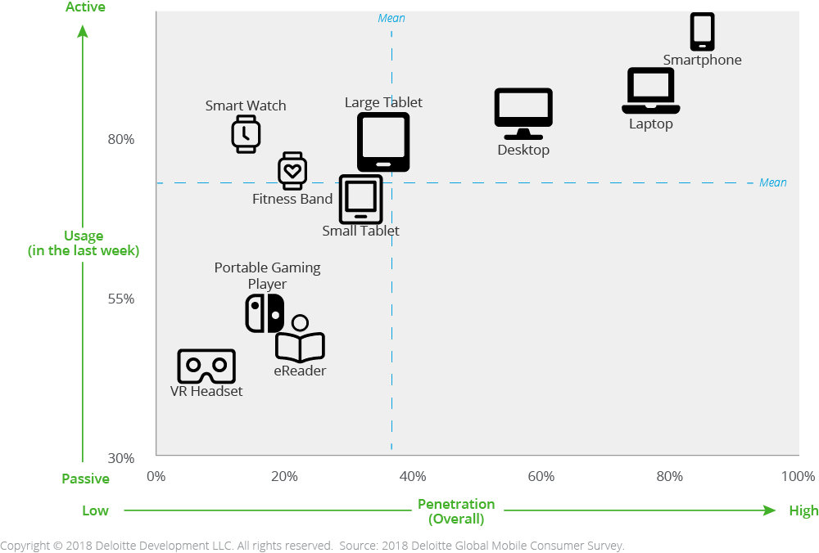
Advantages of Mobile Devices
Deloitte Global Mobile Consumer Survey: United States 2018 Statistics

Slide 11
Alex’s Categories of mHealth
Education, reminders, and data management
Population health
Physiological signals
Momentary symptom assessment
Continuous health management
Focus of this course

Slide 12
1. Education, Reminders, and Data Management
Leverages the communication capabilities of mobile devices to support existing practices for healthcare management
Improved access to health information
Multimedia guidebooks for remote medical decision-making
Reminders for medication adherence and clinic visits
Digital forms for facilitating data entry

Slide 13
1. Education, Reminders, and Data Management
Example: Ngabo et al. '12
Motivation: Maternal deaths in low- and middle-income countries are often due to delays in health-related decision-making as a result of adverse events
Opportunity: SMS can be used to scaffold communication between community health workers and mother-infant pairs

Slide 14
2. Population Health
Leverage trends across communities to understand population-level trends
Urban mobility and access to green space
Epidemic monitoring and contact tracing
Community-level predictors of long-term health

Slide 15
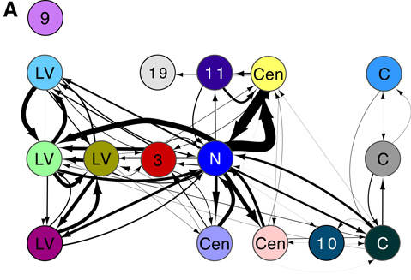
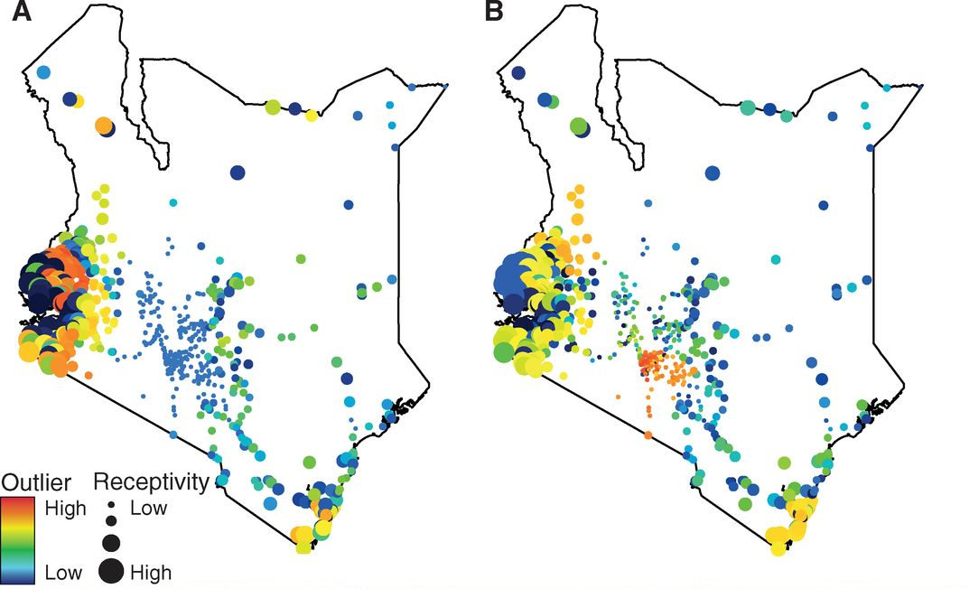
2. Population Health
Example: Wesolowski et al. ‘13
Motivation: Identifying the “sources” and “sinks” of malaria transmission due to human travel would improve malaria control in Kenya
Opportunity: Smartphone mobility data (i.e., cell tower connections) can be used to approximate travel to and from major cities and villages

Slide 16
3. Physiological Signals
Measure continuous, real-time indicators of health that apply to the population at large
Heart rate (HR), heart rate variability (HRV), and stress
Blood pressure
Maximal oxygen consumption (VO₂ max)
Oxygen saturation (SpO₂)
Step count
Gait speed and stride length

Slide 17
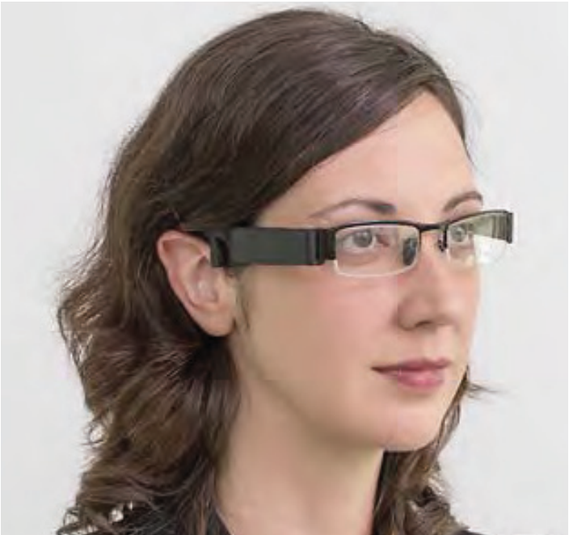
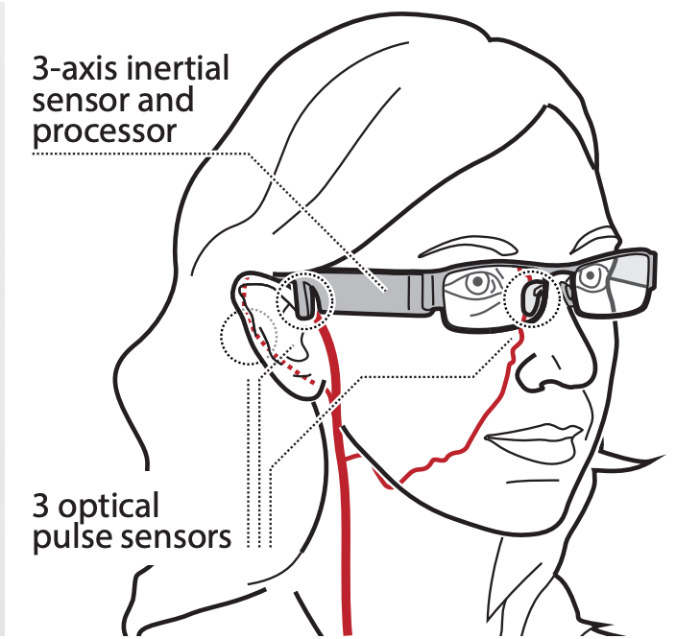
3. Physiological Signals
Example: Holz and Wang ‘17
Motivation: Blood pressure naturally varies throughout the day, so any one-time measurement is likely to be confounded
Opportunity: Photoplethysmography (PPG) sensors can be embedded in glasses to continuously measure pulse transit time, which is related to blood pressure

Slide 18
4. Momentary Symptom Assessment
Ask users to go through an explicit procedure with their phone (e.g., perform a gesture, take a selfie) to take a measurement
Finger tapping task for fine motor control
Timed up-and-go (TUG) walking task for mobility
Place finger over the camera or selfie recording for PPG
Picture of skin lesion for skin cancer identification

Slide 19
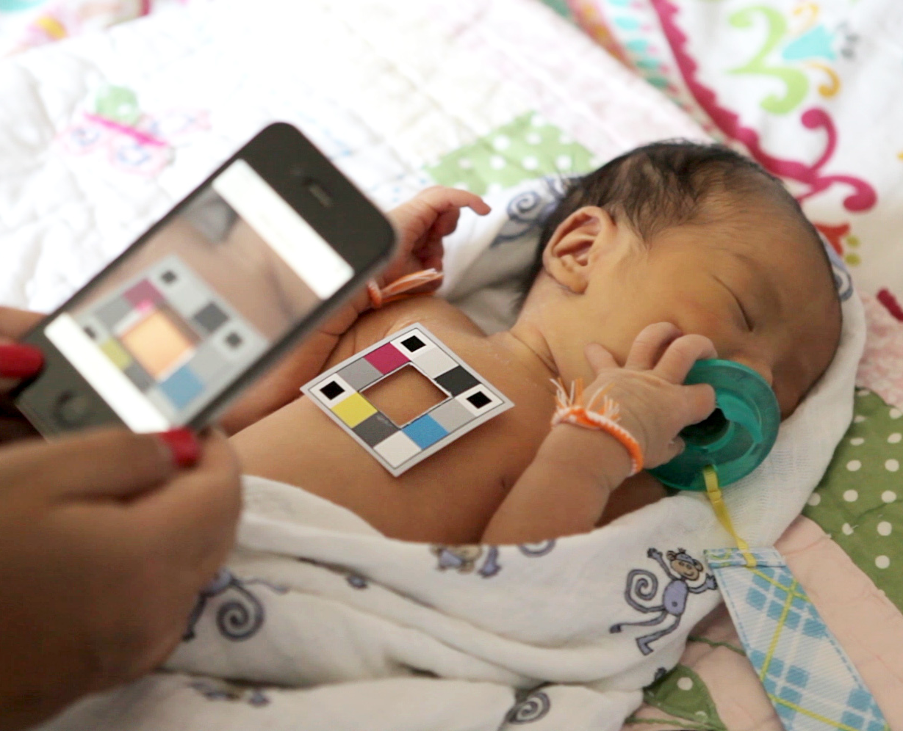
4. Momentary Symptom Assessment
Example: de Greef et al. ’14
Motivation: Neonatal jaundice is subjective and difficult for new parents to identify
Opportunity: The smartphone’s camera can accurately and objectively measure colors, which can be converted to a bilirubin measurement

Slide 20
5. Continuous Health Management
Leverage passive sensing to continuously measure physiological signals, behaviors, and contextual variables that may indicate a person’s health state
Diabetes monitoring
Cough detection and classification
Influenza-like symptom monitoring
Stress / mental health management
Smoking events
Just-in-time adaptive interventions

Slide 21
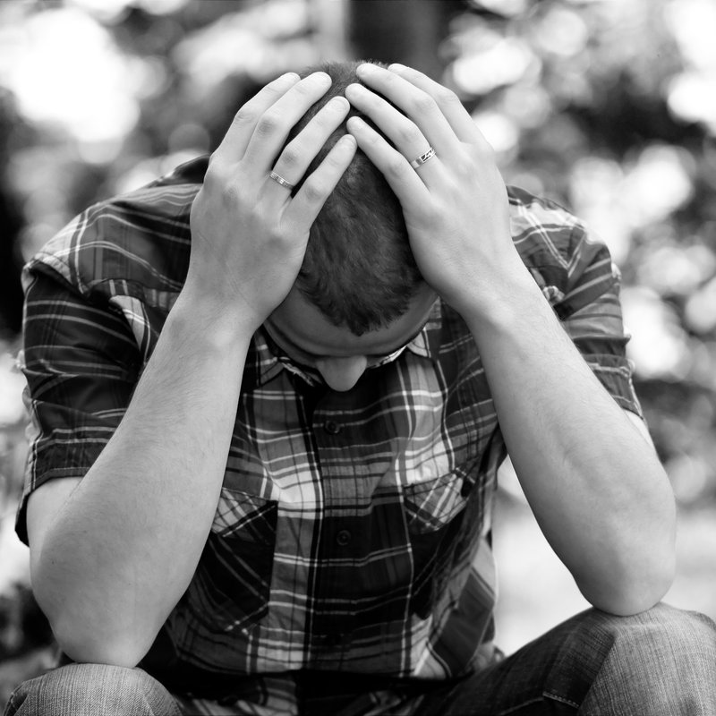
5. Continuous Health Management
Example: Wang et al. ‘16
Motivation: Schizophrenics experience dynamic changes and episodes at a frequent rate yet cannot be constantly monitored by clinicians
Opportunity: Smartphones can measure behavioral, environmental, and contextual indicators of mental health status (e.g., activity level, sleep duration, location)

Slide 22
Momentary vs. Continuous Assessment
Momentary (Active) Assessment
Continuous (Passive) Assessment
More control over where, when, and how data is collected
Requires users to remember to test themselves
May require expertise to be used properly
Designed to collect data passively without needing user involvement
Richer time resolution of data
Enables opportunistic interventions
Limited control over where, when, and how data is collected
More things can go wrong due to higher measurement frequency

Slide 23
Alex’s Categories of mHealth
Education, reminders, and data management
Population health
Physiological signals
Momentary symptom assessment
Continuous health management

Slide 24
Challenges in mHealth
Note: Phones can be augmented with attachments
Trade-offs in hardware sophistication
Dedicated Hardware
Need strategy to distribute at scale
Can be specifically designed to requirements
Complete control over hardware and software
Low-End Smartphones | High-End Smartphones
Most ubiquitous | Limited to tech-savvy
Limited sensors | Better sensors
At the mercy of smartphone manufacturers and developers
Deployability
Instrumentation
Control
Which endpoints should we target for which use cases?
Notes:
Smartphone-based mHealth can inform the design of future devices through accelerated discovery

Slide 25
Challenges in mHealth
Designing for non-expert users
 | Research Study
Device Operator | A researcher or study coordinator familiar with the data
Environment | Controlled lab environment
Clinical Deployment
Doctors, EMTs, and nurses with training
Hospital lighting, consistent noise
Smartphones
Ordinary people without training
Anywhere
How do we ensure everything data is high quality?
How do guide people to use mHealth tools properly?

Slide 26
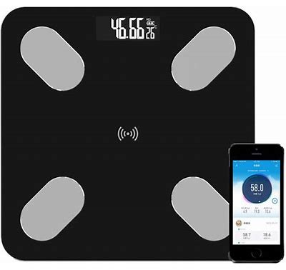
Challenges in mHealth
Designing for non-expert users
Doctors are trained to interpret medical information, ordinary people are not
Even the “simplest” data can lead people to illogical conclusions
Example on weight scales: Kay et al. ‘13
How are people supposed to interpret their data?
What are people supposed to do with their results?

Slide 27
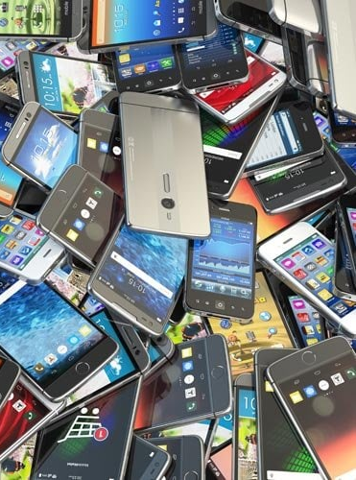
Challenges in mHealth
Not all smartphones are created equal
Different sensor specifications
Sampling rate
Camera color sensitivity
Different physical layout of sensors
Relative position of microphone and speaker
Relative position of camera and flash
Relative position of vibration motor and accelerometer
Different levels of API access
How do we ensure mHealth apps work for all phones?

Slide 28
Challenges in mHealth
Deciding on the most appropriate baseline(s)
Selecting an appropriate baseline for model training and evaluation depends on more than just accuracy
Example: Imagine we are developing a system to measure stress throughout the day. What would be the best approach for comparison?
Salivary cortisol test: accurate, but extremely inconvenient
Stress survey (PHQ-9): very subjective, but easy to complete
Are we training models on the right labels?
Are we comparing our systems to the right baseline?

Slide 29
Challenges in mHealth
Endless potential for bias
Examples of demographic bias
PPG: skin tone
Cough counting: voice characteristics across genders
Pupil measurements: eye color
Other examples
Step counting: device placement (e.g., pockets but not purses)
Any project: device model
Any project: data collection environment for targeted populations
How do we identify and mitigate these potential biases?

Slide 30
Challenges in mHealth
Trade-offs in hardware sophistication
Designing for non-expert users
Data collection
Interpretation
Not all smartphones are created equal
Deciding on the most appropriate baseline(s)
Endless potential for bias

Slide 31
TODO: Maintaining Retention
https://www.nature.com/articles/s41746-020-0224-8

Slide 32

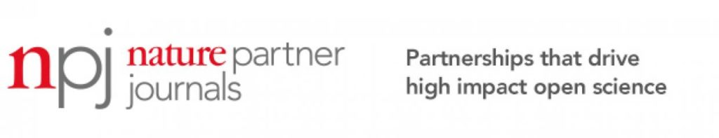


Some Venues to Explore
In no particular order:
ACM HEALTH
ACM IMWUT
EAI PervasiveHealth
JMIR mHealth & uHealth
NPJ Digital Medicine

Slide 33
Resources
mHealth for Development (United Nations & Vodafone Foundations)
mHealth and Applications (Choe et al. ‘21)
Challenges in Realizing Smartphone-Based Health Sensing (Mariakakis et al. ‘19)

Slide 34
Questions?

